Slide 1
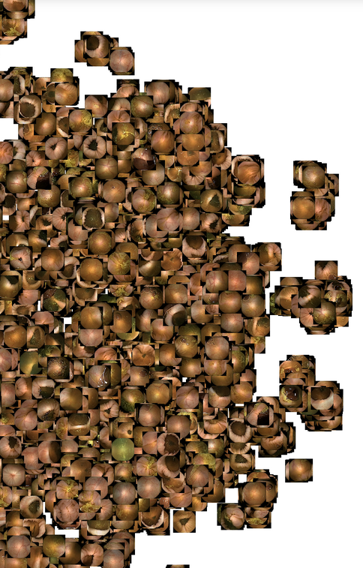
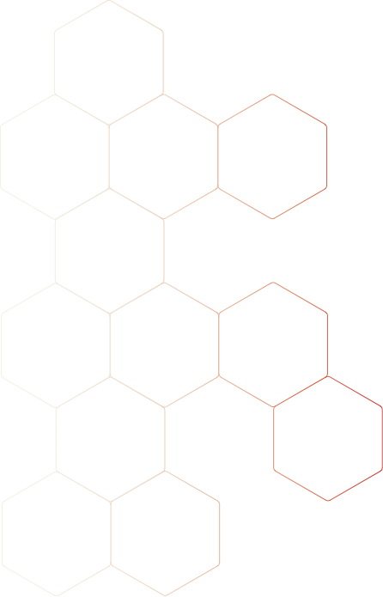
WebApp results & Learning to Sort
Pere Gilabert Roca
October, 2020

Slide 2
Index
Medical Experiments. WebApp results
Learning to Sort

Slide 3
1. Medical Experiments. WebApp results

Slide 4
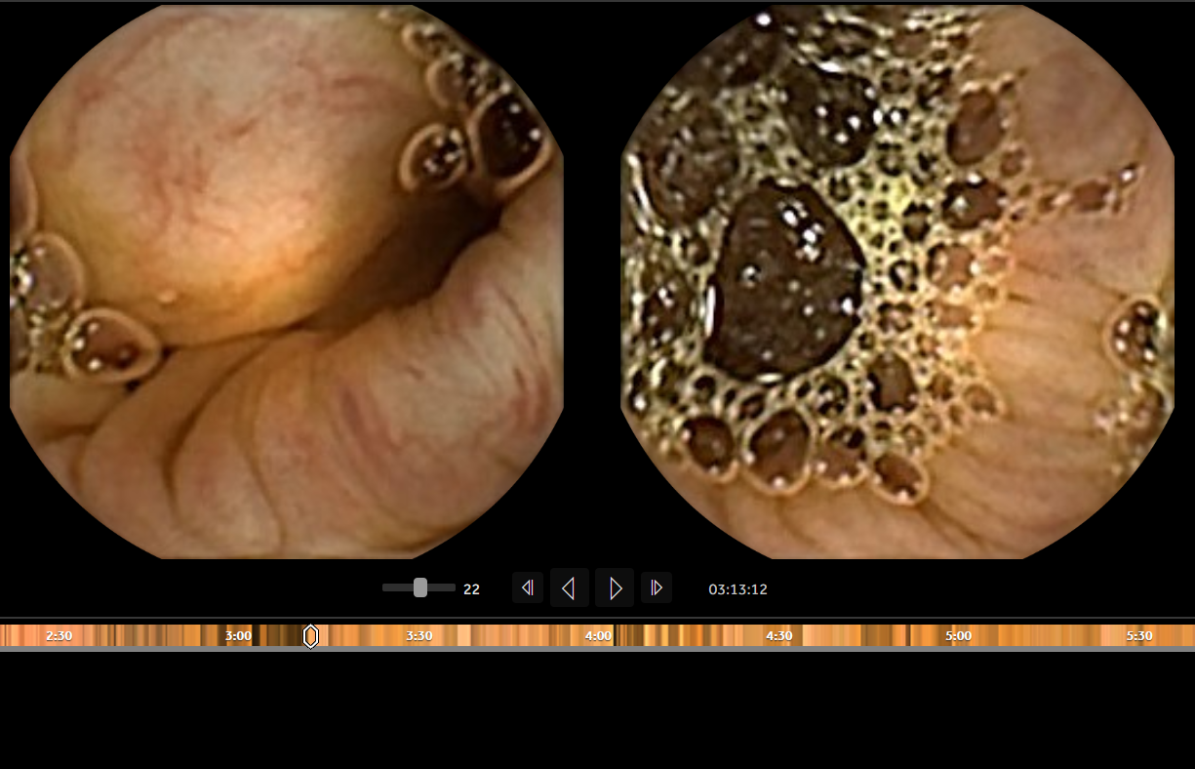
The Problem
Videos are over 8h long
Doctors spend a lot of time revising frames
Videos are accelerated to reduce reviewing time
Frontal and Back Camera are show at once
Some polyps appear in just one frame
Rapid Software

Slide 5
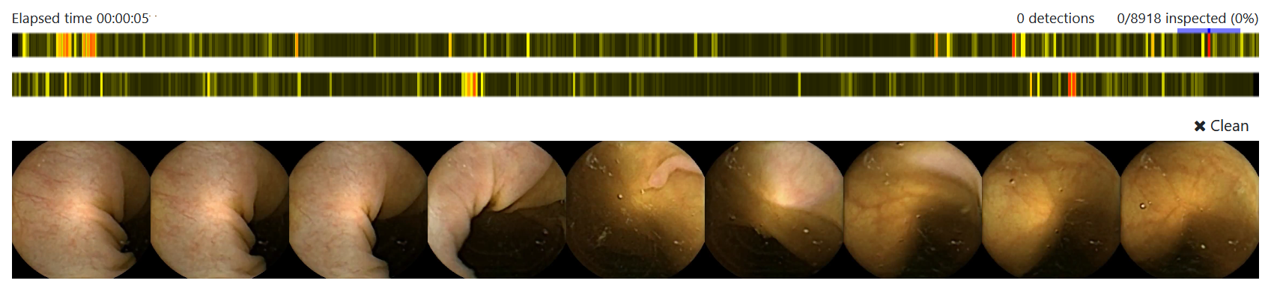
Our propose
WebApp that helps physicians to visualize images with the highest score
Give context by showing near frames

Slide 6
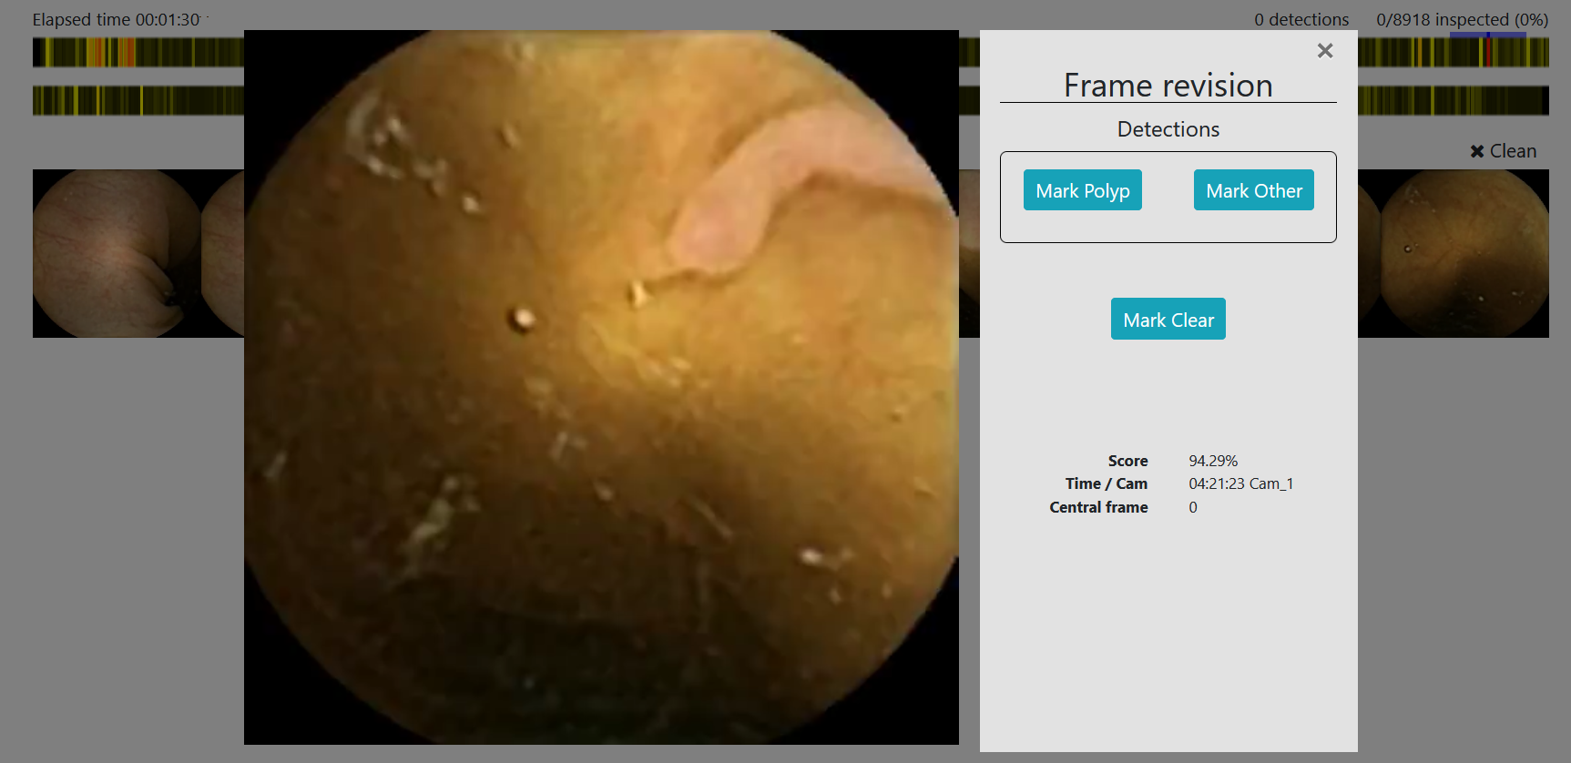
Our propose
WebApp that helps physicians to visualize images with the highest score
Give context by showing near frames
Frames can be enlarged for a better visualization

Slide 7
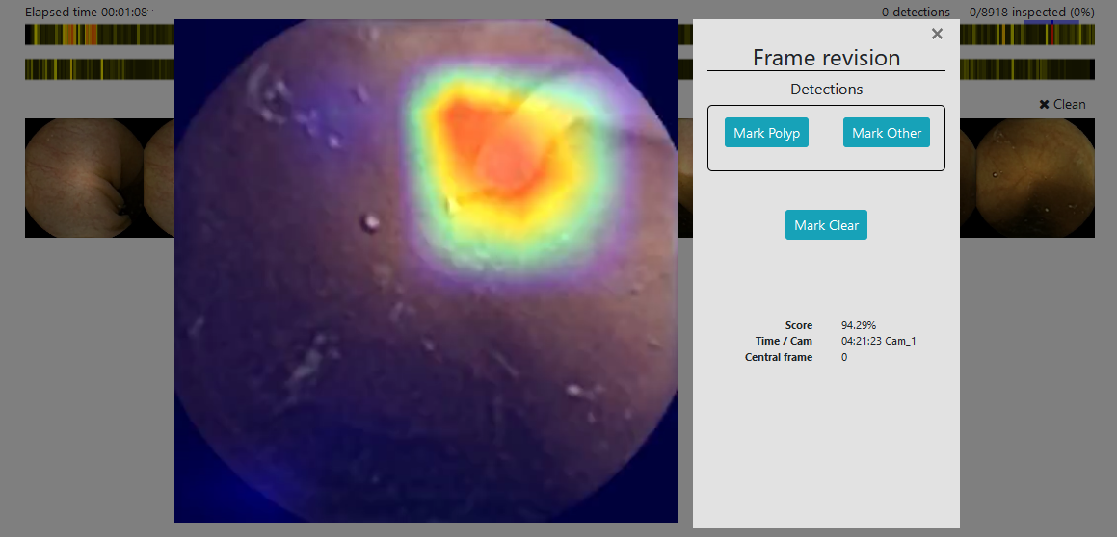
Our propose
WebApp that helps physicians to visualize images with the highest score
Give context by showing near frames
Frames can be enlarged for a better visualization

Slide 8



Experiments
3 Experts from CAPRI
3 Non-experts from Vall d’Hebron
22 Videos to revise
2 Tools used: Rapid Software & WebApp

Slide 9
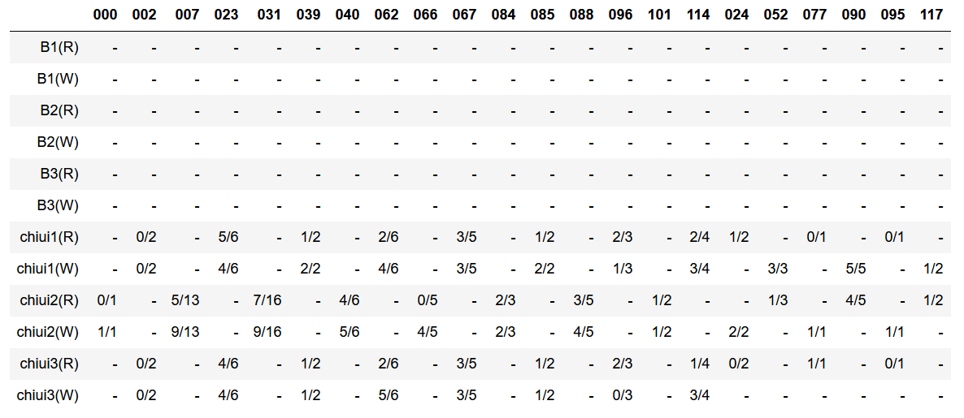
Results

Slide 10
Results

Slide 11
Results

Slide 12
Results

Slide 13
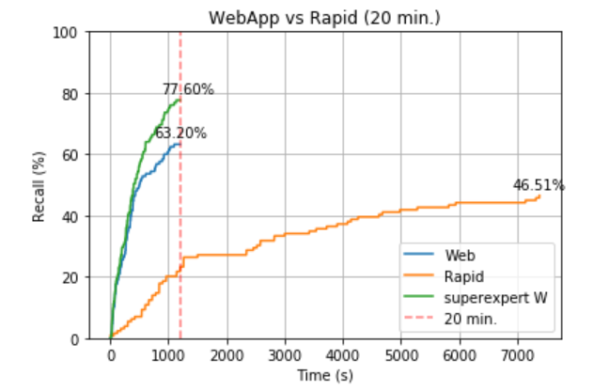
Results
20 min of app total use
Time is reduced in a factor of 6
More polyps detected when using the app

Slide 14
2. Learning to Sort

Slide 15
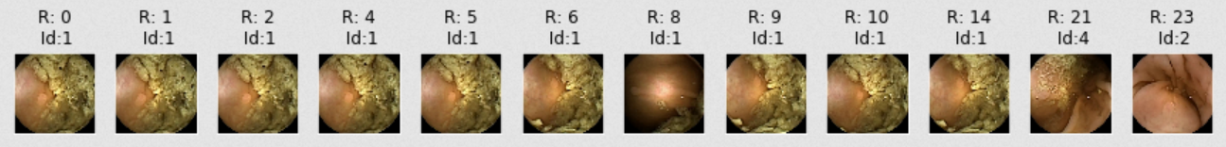
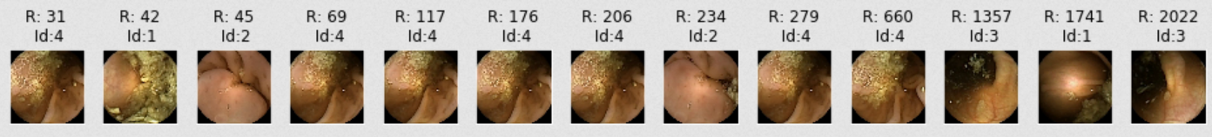
The Problem
Assuming that the network works as expected…
93.2%
6.6%

Slide 16
The Goal
Sort frames in a relevant way so the variability of polyps is show in early stages.
93.2%
6.6%

Slide 17
The Goal
Sort frames in a relevant way so the variability of polyps is show in early stages.
93.2%
6.6%

Slide 18
The Goal
Sort frames in a relevant way so the variability of polyps is show in early stages.
93.2%
6.6%

Slide 19
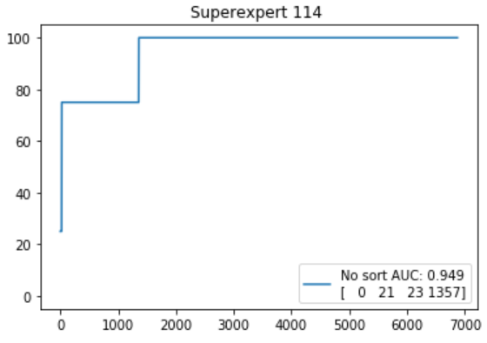
Superexpert
Never misses a polyp
Encoded in a superexpert curve

Slide 20
Objective function
Cost function can include a combination of these three metrics:
Temporal frame distance
Embedding distance
Score similarity

Slide 21
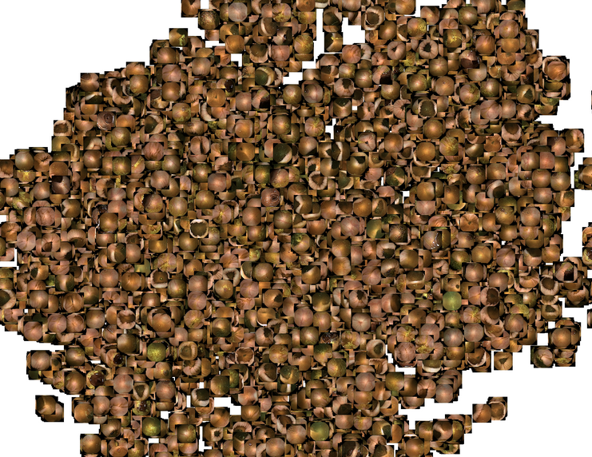
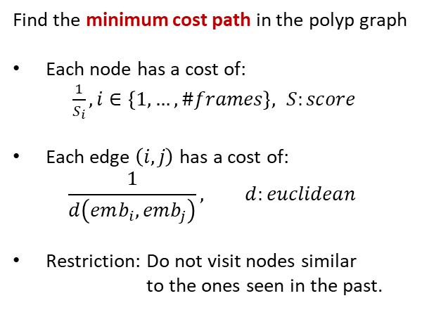
Some Ideas (1): Travel Salesman Problem (with memory)
Find the minimum cost path in the polyp graph
Each node has a cost of:
$\frac{1}{S_{i}}, i∈\left\{1, …, \#frames\right\}, S:score$
Each edge $\left(i,j\right)$has a cost of:
$$\frac{1}{d\left(emb_{i}, emb_{j}\right)}, d:euclidean$$
Restriction: Do not visit nodes similar to the ones seen in the past.

Slide 22
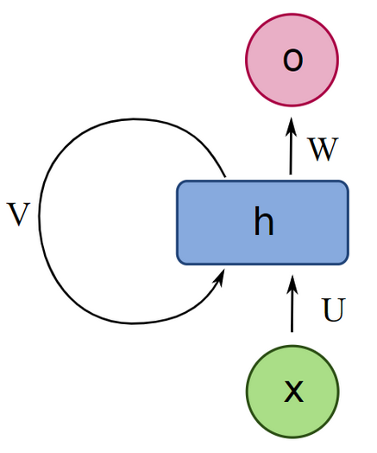
Some Ideas (2): Recurrent Neural Network
Learn to predict frames that are different from those seen so far but have a high probability of containing a polyp

Slide 23
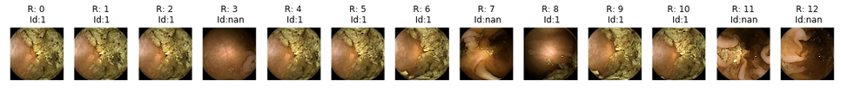
Some Ideas (3): ResNet Embeddings (Greedy approach)
Imagine that we have the following list of images that the physician is going to revise.
This can be seen as a priority queue initially sorted by the probability of containing a polyp.

Slide 24
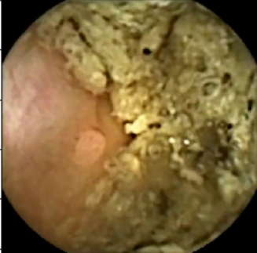
Some Ideas (3): ResNet Embeddings (Greedy approach)
Get the frame with the highest score

Slide 25
Some Ideas (3): ResNet Embeddings (Greedy approach)
Get the frame with the highest score
Compute its embedding and retrieve most similar images

Slide 26
Some Ideas (3): ResNet Embeddings (Greedy approach)
Get the frame with the highest score
Compute its embedding and retrieve most similar images
Move images at the end of the queue
...
Queue:

Slide 27
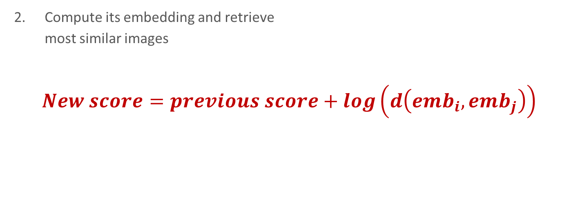
Some Ideas (3): ResNet Embeddings (Greedy approach)
Get the frame with the highest score
Compute its embedding and retrieve most similar images
$New score=previous score+log\left(d\left(emb_{i}, emb_{j}\right)\right)$
Move images at the end of the queue
Queue:
...

Slide 28
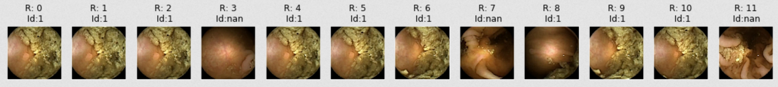
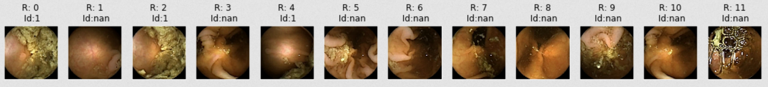
Some Ideas (3): ResNet Embeddings (Greedy approach)
Results
Before sorting
After sorting

Slide 29
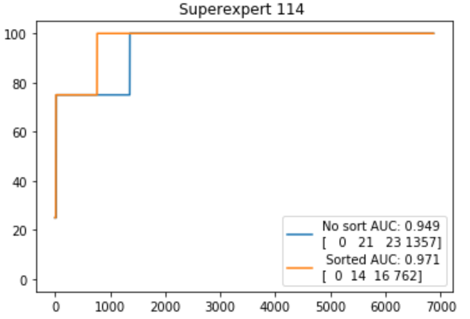
Some Ideas (3): ResNet Embeddings (Greedy approach)
Results

Slide 30
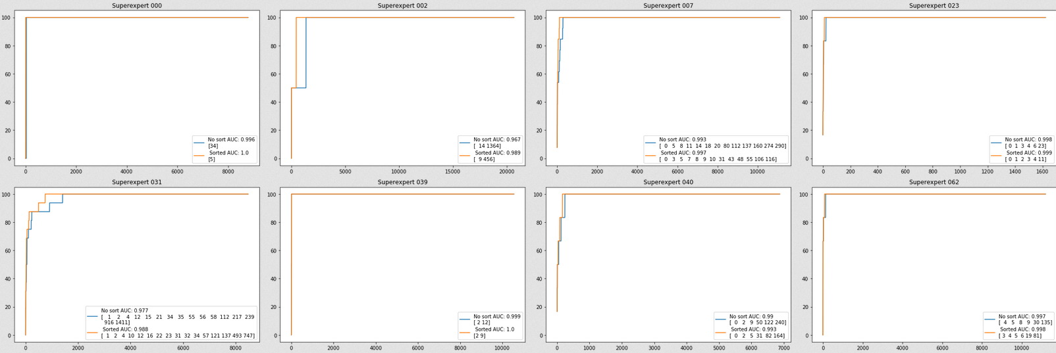
Some Ideas (3): ResNet Embeddings (Greedy approach)
Results

Slide 31
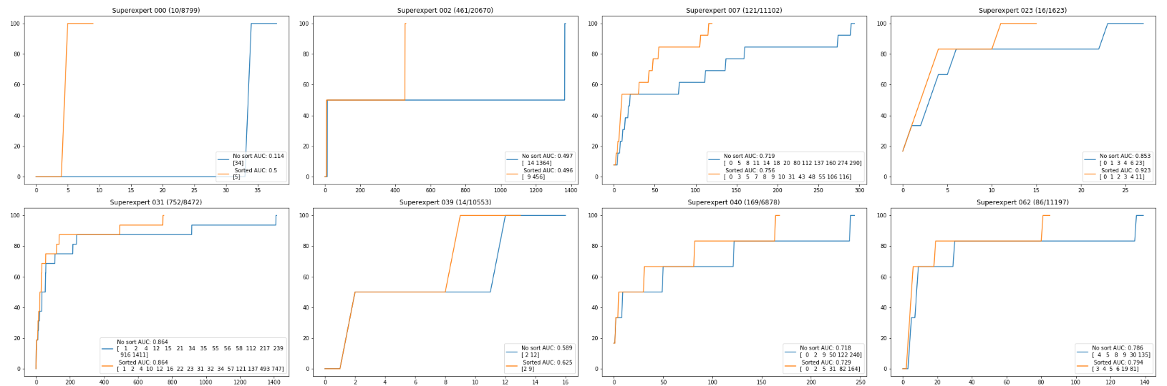
Some Ideas (3): ResNet Embeddings (Greedy approach)
Results

Slide 32
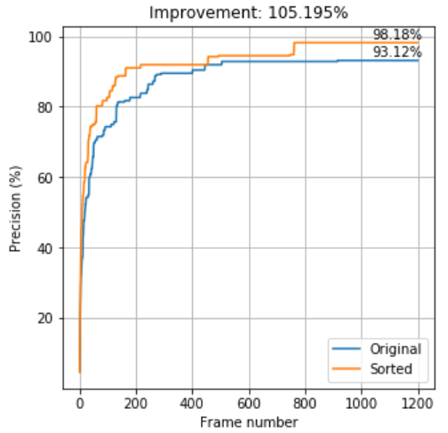
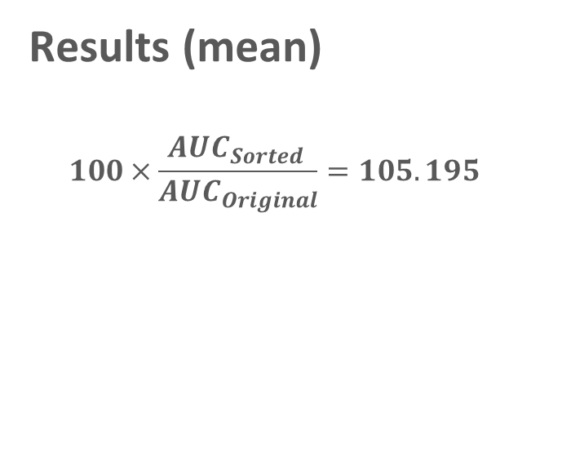
Some Ideas (3): ResNet Embeddings (Greedy approach)
Results (mean)
$$100×\frac{AUC_{Sorted }}{AUC_{Original}}=105.195$$

Slide 33

Thanks!

